Slide 1

TRIZ and IT
Draw the Future
Introductory webinar
1

Slide 2
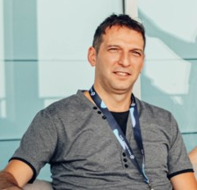
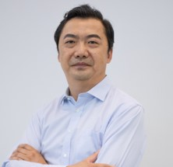
Speakers
Ramez Kassou
拉梅兹卡苏
Jason Wang
王健
Ph.D. in Standardization and quality management
M.Sc. In Information Security
Certified TRIZ specialist (level 4)
Head of “TRIZ in IT” at TDS
>10 patents in IT and High-tech
M. Sc. In Power Electronics and Motor Control, THU
Innovation Mentor of X-lab, THU
MD of Smart Factory Institute
Founder of E-cube Incubator
Founder&CEO of IMA Innocloud
2

Slide 3
01
02
03
ABOUT TDS
TRIZ Tools
TRIZ and IT Interaction
TABLE OF CONTENTS
04
05
06
Developing IT systems via TRIZ
Developing TRIZ via IT
Research & Opportunities
The organization and conference sections
Methods of invention and innovation
4 Approeaches of methodological integration
The potential of TRIZ usage in solving SW and HW problems.
Roadmapping TRIZ projects
Compinno-TRIZ Software
TRIZ in IT workgroup. Agenda and milestones.
3

Slide 4

01
ABOUT TDS
TRIZ Developers Summit
The organization and conference sections
4

Slide 5
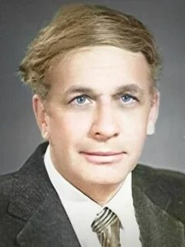
— Genrikh Altshuller
(Find an idea. Introduction to TRIZ - the theory of inventive problem solving)
“..a technical object is ideal if it does not exist, and its function is performed”
5

Slide 6
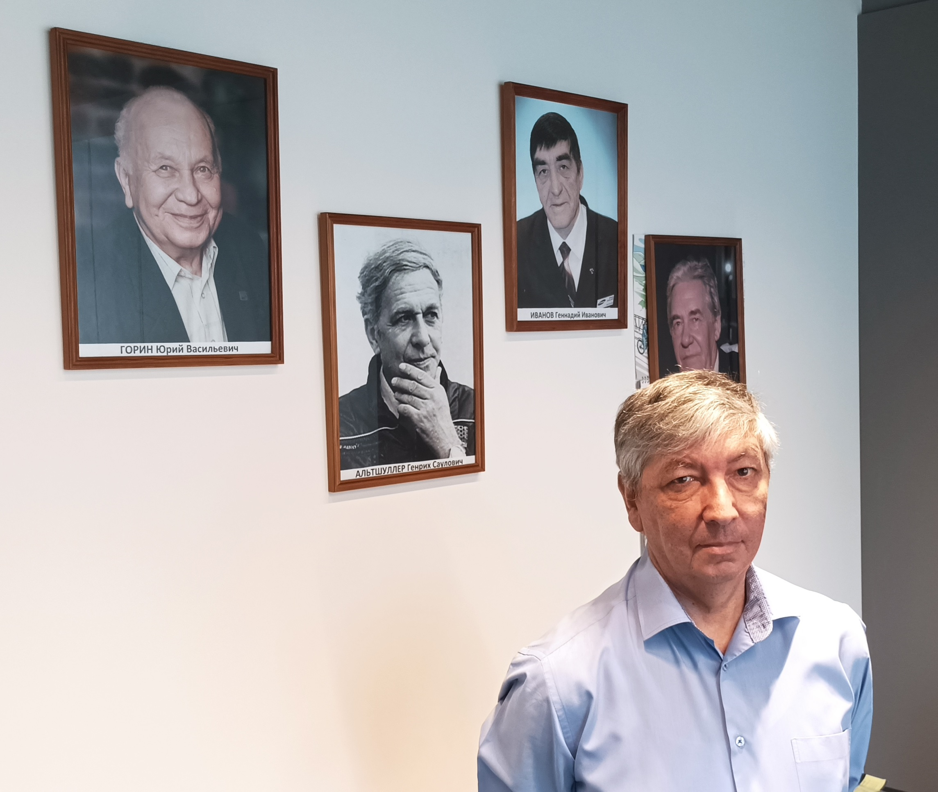
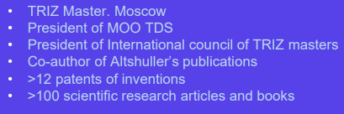
The Organization of TRIZ Developers Summit
Mikhail Rubin
Network of methodologists and experts
Infrastructure of specialists certification
Research activities
Conference and publication
Competitions
6

Slide 7
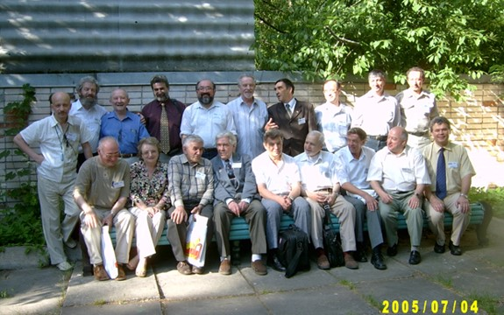
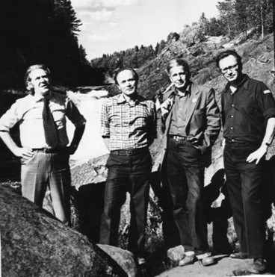
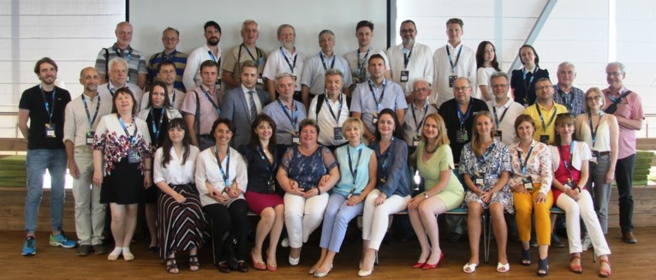
Karelia. 1980 year.
Petrozavodsk TRIZ seminars.
St. Petersburg. 2005. 1st meeting of the TRIZ Developers Summit.
Minsk. 2019.
XV Conference of the TRIZ Developers Summit.
7

Slide 8
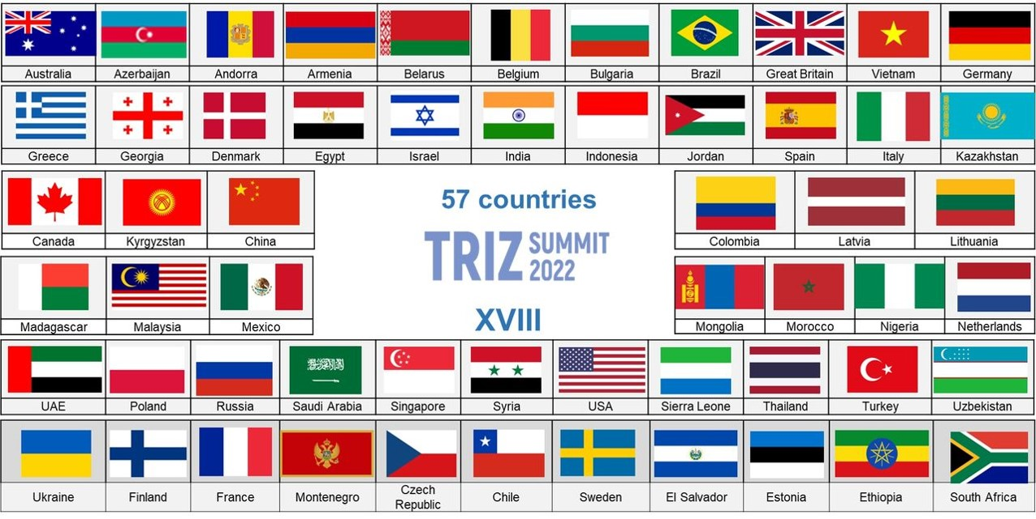
TDS Conference 2022
8
71.4% of the world's population (5.6 billion people)
69.2% of all world countries area

Slide 9
TDS Conference Sections
TRIZ in Education and Creative Personality
TRIZ in Business
TRIZ in IT and Technology
9

Slide 10
TRIZ Tools
What is TRIZ?
TRIZ nowadays
10

Slide 11
TRIZ Nowadays
Classical TRIZ
Invention and innovation delivery
Altshuller matrix and principles for solving contradictions
Laws of technical systems’ evolution
ARIZ
...
TRIZ civilization
Modern TRIZ-based methods
Functional modeling
Cause-effect chains analysis
Benchmarking and feature transfer
MPV analysis
...
Integration with TRIZ
Time
Design Thinking
Purchasing Chessboard
6 Sigma
Lean manufacturing
...
TRIZ basics investigation
TRIZ applied in companies
TRIZ for Business
TRIZ for IT
11
Notes:
Criteria of TRIZ-based activity:
- formulating and solving contradicting demands
- solving non-trivial tasks
- patenting system or a method after applying a TRIZ classical or modern tool
- Applying TRIZ by qualified and certified personal

Slide 12
Questions & Answers
3. TDS cutting-edge topics
2. Main problems of TRIZ
1. Examples of TRIZ integration
12
Notes:
Q1.1: You mentioned TRIZ integration. Could you give an example on how Triz works with other tools like design thinking and 6-sigma?
Q1.2: What are the main problems that Triz facing currently on its own development and spreading around the world?
Q1.3: How about the size of TDS last year? What are the most interesting and/or most cutting-edge topics on TDS in these years?

Slide 13
TRIZ and IT Interaction
Approach 1: Developing IT-systems via TRIZ
Approach 2: Enriching TRIZ tools by cases in IT
Approach 3: Laws and trends of evolution
Approach 4: Developing creative personalities
13

Slide 14
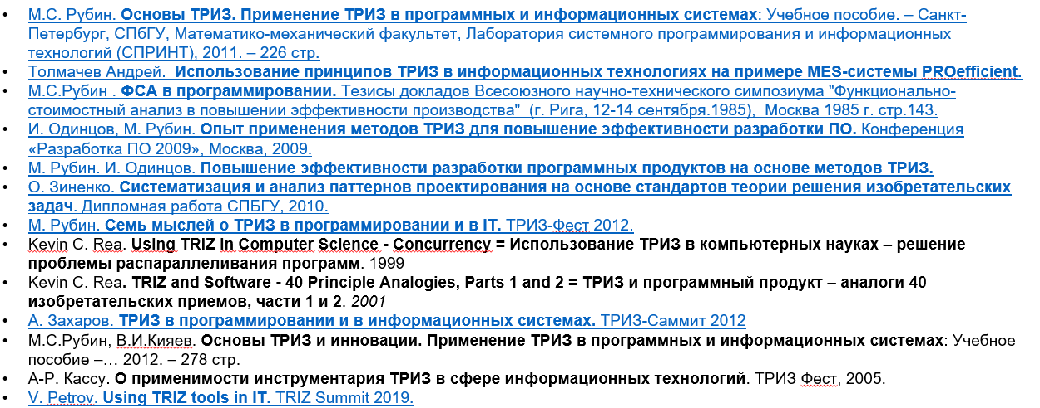
Approach 1: Developing IT-systems via TRIZ
Some TRIZ tools can be successfully used in the field of IT systems development and in solving inventive tasks there.
There are case studies of successful application of TRIZ at different stages of software development, in the development of sensors and electronic circuits for IT systems.
Features
  Techniques for resolving contradictions and standards for solving inventive tasks developed for technology are not always applicable to information systems.
  The operational conflict zone in information systems does not always coincide with any physical space and is associated with the space of abstract parameters.
  The laws of the development of technical systems do not fully describe the development of IT systems.
14

Slide 15
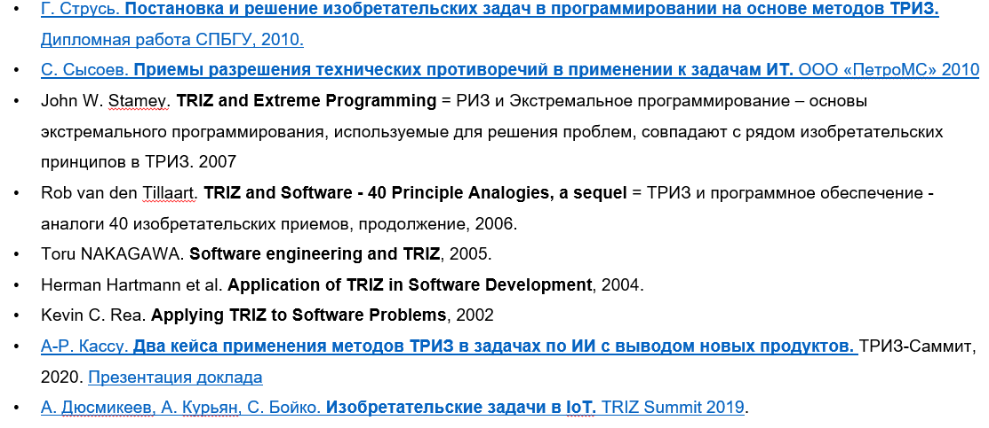
Approach 2: Enriching TRIZ Tools by Cases in IT
There are practically no systematic files of inventions in the field of IT systems development and their analysis.
In the literature, you can find no more than a hundred examples of TRIZ analysis of inventions in this field. This is not enough for the necessary level of generalizations that allow us to identify new tools for solving problems, techniques and lines of development that are specific to IT systems.
Features
Patents for inventions can be one of the systematic sources of information about inventions in the field of IT. To do this, it is possible to distinguish several classes of IPC, rank inventions in these classes according to five levels of inventions adopted in TRIZ and try to make the necessary generalizations on tools for solving problems in IT.
For example, the IPC class G06K - Data recognition; data representation; data reproduction; manipulation of information carriers; information carriers.
15

Slide 16
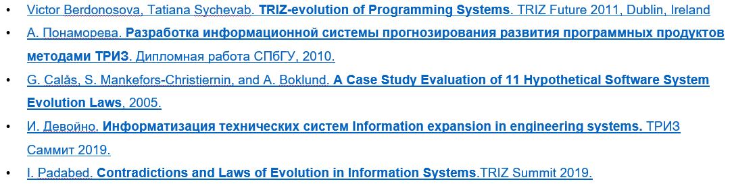
Approach 3: Laws and Trends of Evolution
In TRIZ, efforts are being made to formulate general laws, lines of development and tools for solving inventive IT tasks.
The most complete and instrumental usage in IT is a set of laws for the development of functional target systems, which, in particular, includes elements of goal-setting, decision-making and feedback systems.
Features
To conduct research in this direction, it is necessary to analyze the applicability of the proposed set of laws for the development of functional target systems to the evolution of IT systems and the solution of inventive tasks in this area.
It is necessary to collect and analyze information about the evolution of IT systems in order to formulate laws and lines of their development.
16

Slide 17
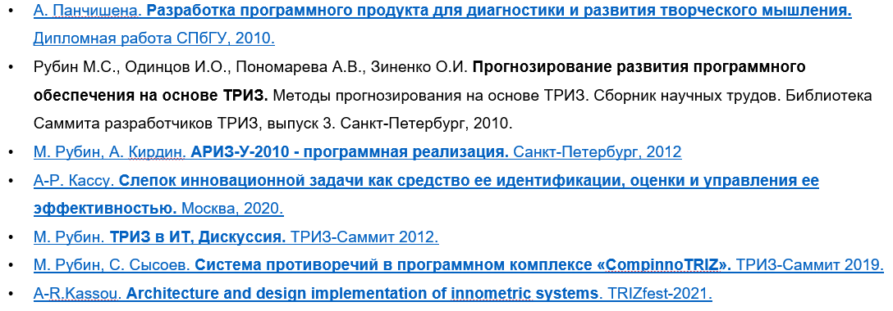
Approach 4: Developing Creative Personalities
The growth of practices of using IT systems in the implementation of the TRIZ tool environment via project and consulting activities leads to an increase in options and methods for collecting, processing and visualizing data on analysis and solving inventive tasks (from different industries).
Features
The development and usage of IT systems with elements of artificial intelligence, to serve the needs of users for the formation and solution of inventive and creative tasks, brings to a new level the practice of performing project and consulting activities on TRIZ.
The development and application of IT systems in the tasks of training and certification of TRIZ helps to scale the practice of mentoring and online coaching.
17

Slide 18
Questions & Answers
3. Software companies which apply TRIZ
2. Compinno-TRIZ for coaching and consulting
1. Qualified TRIZ masters and R&D team
18
Notes:
Q2.1: Which Triz master or triz researching team is good at such topic?
Q2.2: Could you show a little bit the software/IT system you are using for consulting or coaching?
Q2.3: Which software company in the world is the most successful in applying Triz?

Slide 19
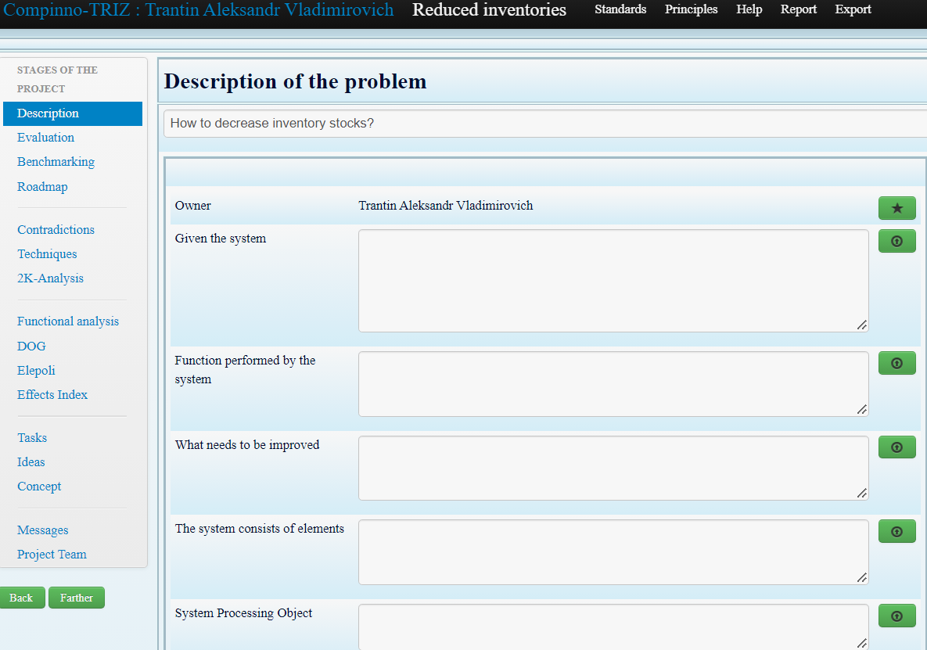
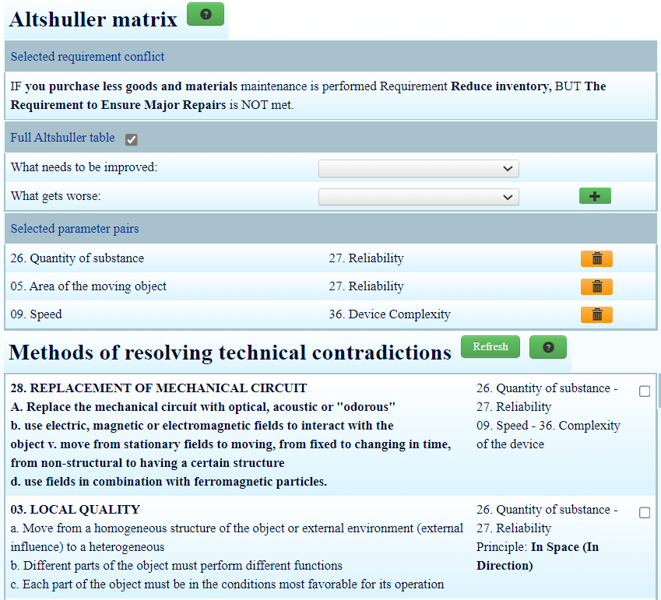
Compinno-TRIZ:
Problem solving service or business-process oriented system for applying TRIZ-tools
Already implemented and used by employees:
Formulation of technical contradictions
Formulation of physical contradictions
IFR
Principles
Functions
Su-field
Benchmarking
RCA
Effects
Roadmap
2K-Analysis
Works with ideas
Team-chat
19
*Automatic translation via Google Chrome

Slide 20

Developing IT Systems via TRIZ
The potential of TRIZ usage in solving SW and HW problems.
20

Slide 21
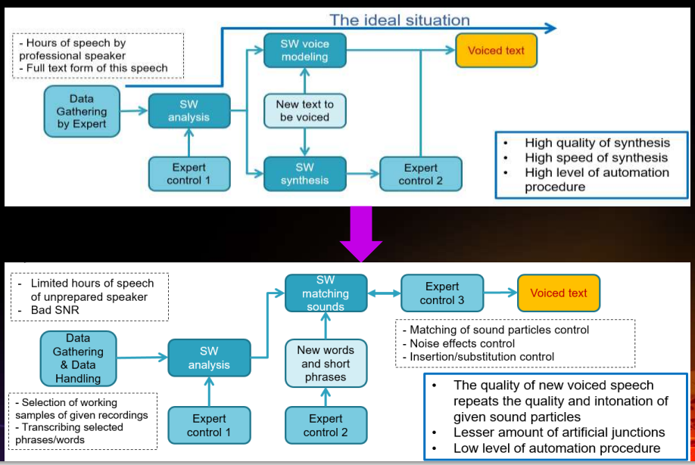
TRIZ Summit 2020:
“Two cases of applying TRIZ methods in AI tasks with the introduction of new products” – by Ramez Kassu
Case 1
21

Slide 22
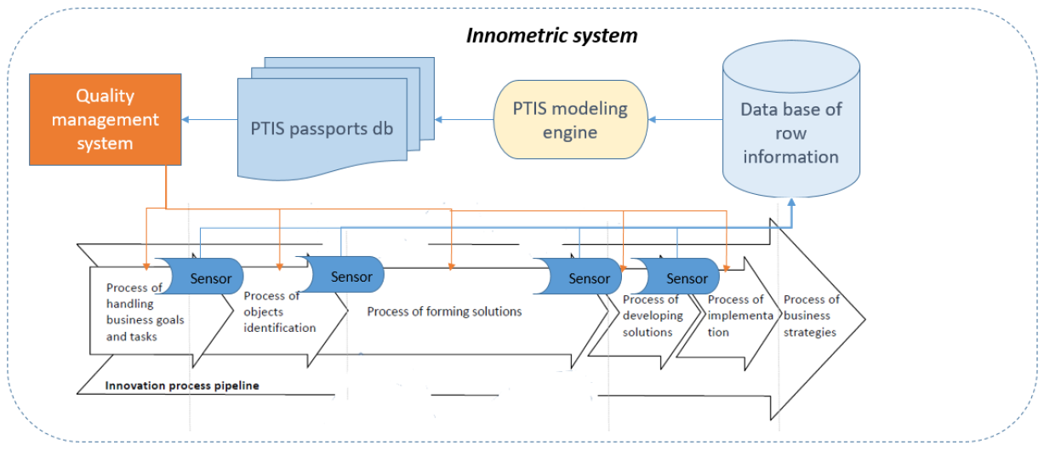
TRIZ Summit 2020:
“Two cases of applying TRIZ methods in AI tasks with the introduction of new products” – by Ramez Kassu
Case 2
22

Slide 23
Questions & Answers
3. SW & HW interaction trends/laws
1. The background of two cases
2. Other use cases at TDS conference
23
Notes:
Q3.1: Tell more about the background of these two stories.
Q3.2: Is there any other use case in this conference?
Q3.3: Is there any evolution law about the interaction or integration between hardware and software?

Slide 24

Developing TRIZ via IT Systems
Roadmapping TRIZ projects
Compinno-TRIZ Software
24

Slide 25
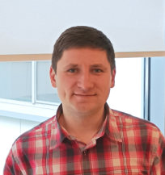
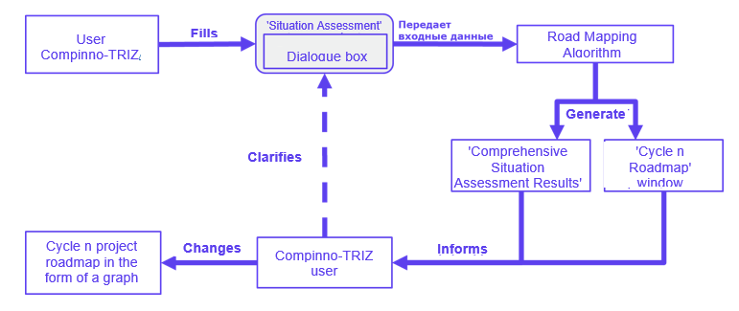
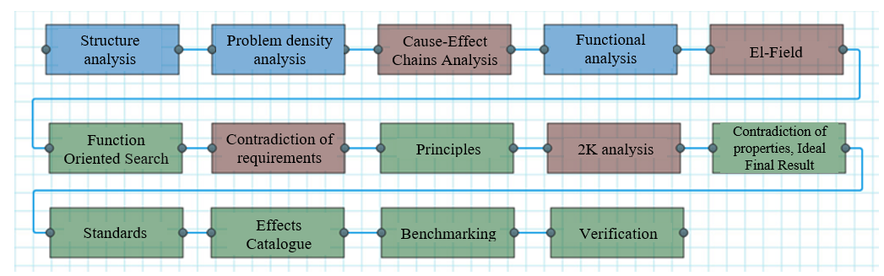
TRIZ Summit 2022:
“Automated construction of roadmaps for TRIZ-projects”
– by Anton Kulakov
25

Slide 26
Questions & Answers
3. The potential of ChatGPT/LLM
2. AI to accelerate knowledge and solving
1. El-field and problem density
26
Notes:
Q4.1: What does it mean of EI-field and problem density?
Q4.2: Is it possible to use AI to accelerate knowledge exploring and find new solution?
Q4.3: What is the potential of ChatGPT or LLM?

Slide 27

Research & Opportunities
TRIZ in IT workgroup.
Agenda and milestones.
27

Slide 28

Agenda
Performing R&D projects to investigate TRIZ and IT integration
Periodical publication of research results on TRIZ-Summit website
IKAR & DEDAL education and certification of IT specialists
Discovering opportunities of collaboration with international participants and partners
28

Slide 29
Milestones - 2023
Q1
Templates and process consolidation
Preliminary set of cases gathering
Q2
Q3
Cases investigation and addressing R&D requirements
Fulfilling database of cases and guide for developers
Q4
29

Slide 30
Questions & Answers
3. Collaboration with China
1. TRIZ & IT workgroup conditions
2. IT\software companies in workgroup
30
Notes:
Q5.1: Current condition of the WG for Triz plus IT?
Q5.2: Is there any IT/software company joining such a WG?
Q5.3: Any collaboration with China?

Slide 31
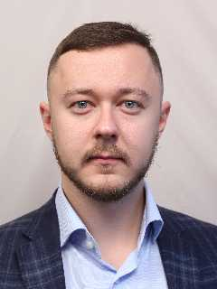
Contact information
Ramez Kassou
Jason Wang
Mikhail Rubin
Anton Kulakov
Alexander Trantin
Mobile: +7 964 370 7873
Wechat: Ramez_Kassou
Email: arkassou@ya.ru
Mobile: +86-1380 1313 660
Wechat: 1906966021
Email: Jason.wang@ima-innocloud.com
Telegram: @Rubin_Mikhail
Skype: mikrubin
Email: mik-rubin@yandex.ru
Telegram: @antonkulakovd
Skype: antonkulakovd
Email: antonkulakovd@gmail.com
Wechat: alexander_sc_brand
Telegram: @Trantin_alexander
Email: Trantin_alexander@hotmail.com
31

Slide 32

Questions?
THANK YOU!
32

Slide 33
Question list:
Q1-1: You mentioned Triz hybrid. Could you give an example on how Triz works with other tools like design thinking and 6-sigma? (Ramez Kassou)
Q1-2: What are the main problems that Triz facing currently on its own development and spreading around the world? (Ramez Kassou)
Q1-3: How about the size of TDS last year? What are the most interesting and/or most cutting-edge topics on TDS in these years? (Ramez Kassou, Mikhail Rubin)
Q2-1: Which Triz master or Triz researching team is good at such topic? (Ramez Kassou)
Q2-2: Could you show a little bit the software/IT system you are using for consulting or coaching? (Ramez Kassou)
Q2-3: Which software company in the world is the most successful in applying Triz? (Ramez Kassou, Alexander Trantin)
Q3-1: Talk more about the background of these two stories. (Ramez Kassou)
Q3-2: Is there any other use case in this conference? (Ramez Kassou)
Q3-3: Is there any evolution law about the interaction or integration between hardware and software? (Ramez Kassou)
Q4-1: What does it mean of EI-field and problem density? (Ramez Kassou, Anton Kulakov)
Q4-2: Is it possible to use AI to accelerate knowledge exploring and find new solution? (Ramez Kassou)
Q4-3: What is the potential of ChatGPT or LLM? (Ramez Kassou)
Q5-1: Current condition of the WG for Triz plus IT? (Ramez Kassou)
Q5-2: Is there any IT/software company joining such a WG? (Ramez Kassou) (this question to the audience too)
Q5-3: Any collaboration with China? (Ramez Kassou, Mikhail Rubin)

